Slide 1

Malicious URL's Detection using NLP and Machine Learning
CIS 600 Applied Natural Language Processing

Slide 2


Table of Contents
Overview
Flowchart
Data Analysis and Visualization
URL Decomposition Techniques
Tokenization Techniques
Machine Learning Techniques
Results

Slide 3
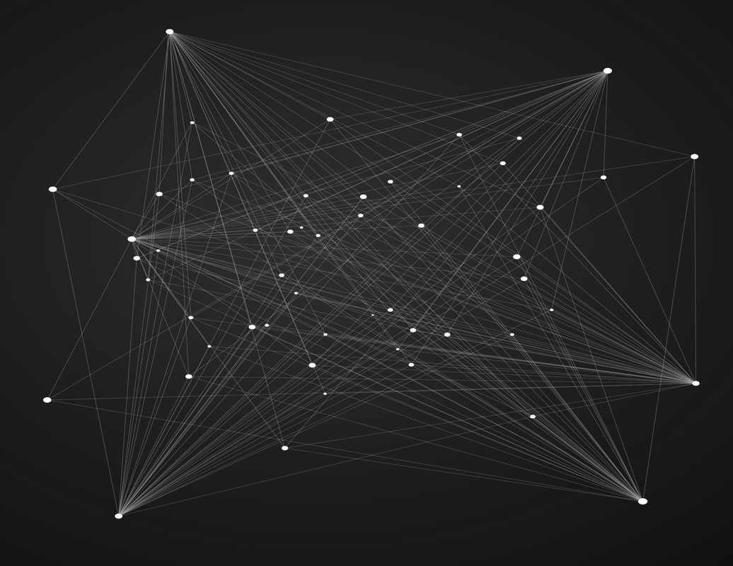
Overview
Leveraging advanced NLP and machine learning techniques to proactively detect and classify harmful URLs, enhancing cybersecurity. Employs BERT embeddings and traditional models like Random Forest for accurate threat analysis. System integrated into a Django-based website for real-time user feedback.

Slide 4
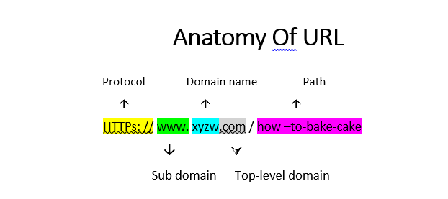

Slide 5
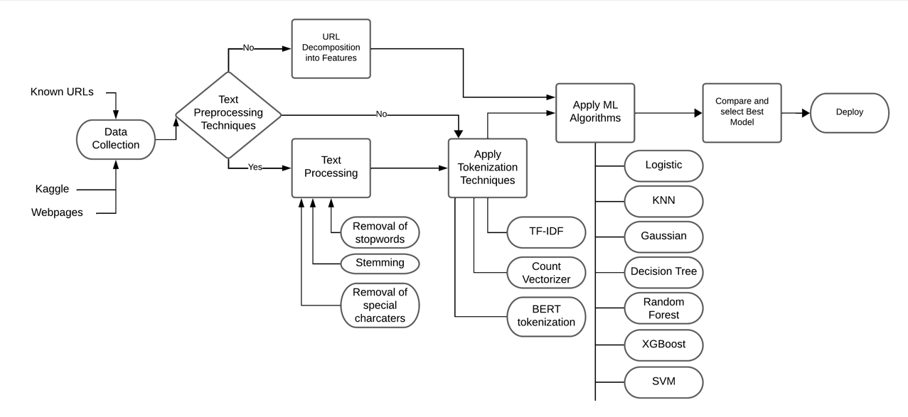
Flowchart

Slide 6



Data Analysis & Visualization

Slide 7
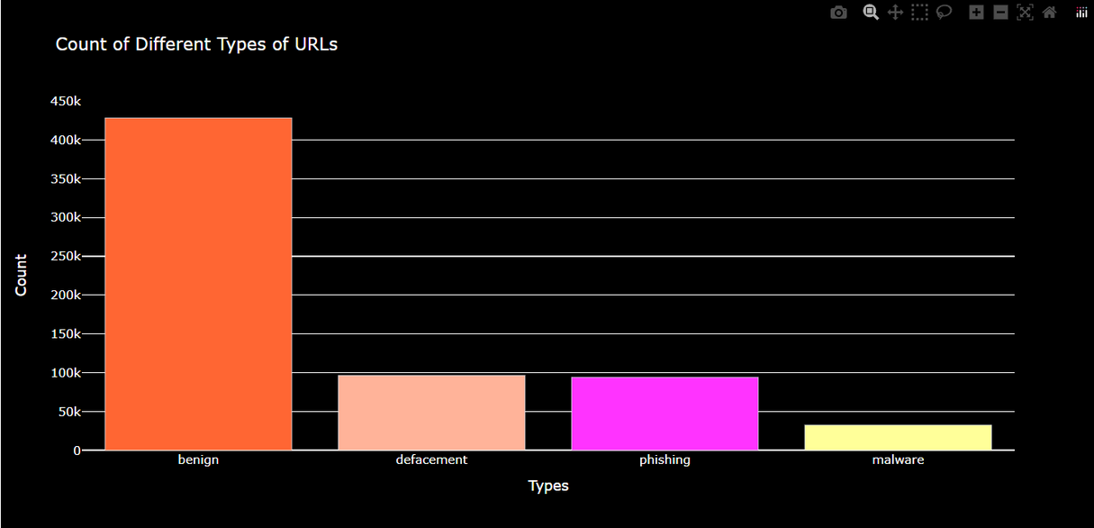
Benign URLs: Safe and legitimate websites.
Defacement URLs: Websites that have been maliciously altered.
Phishing URLs: Deceptive websites that mimic legitimate ones.
Malware URLs: Websites designed to infect visitors' devices.

Slide 8
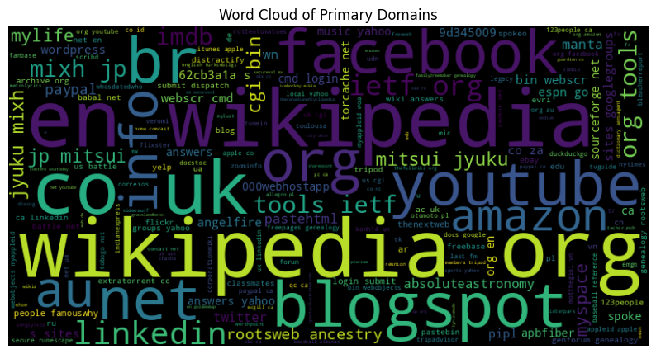
Most Repeated Words In URLs

Slide 9
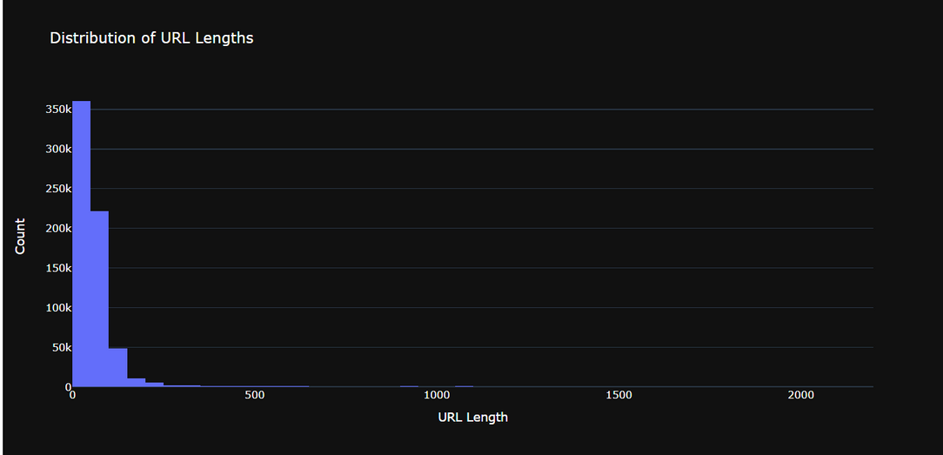
Length Of URLs in the data

Slide 10
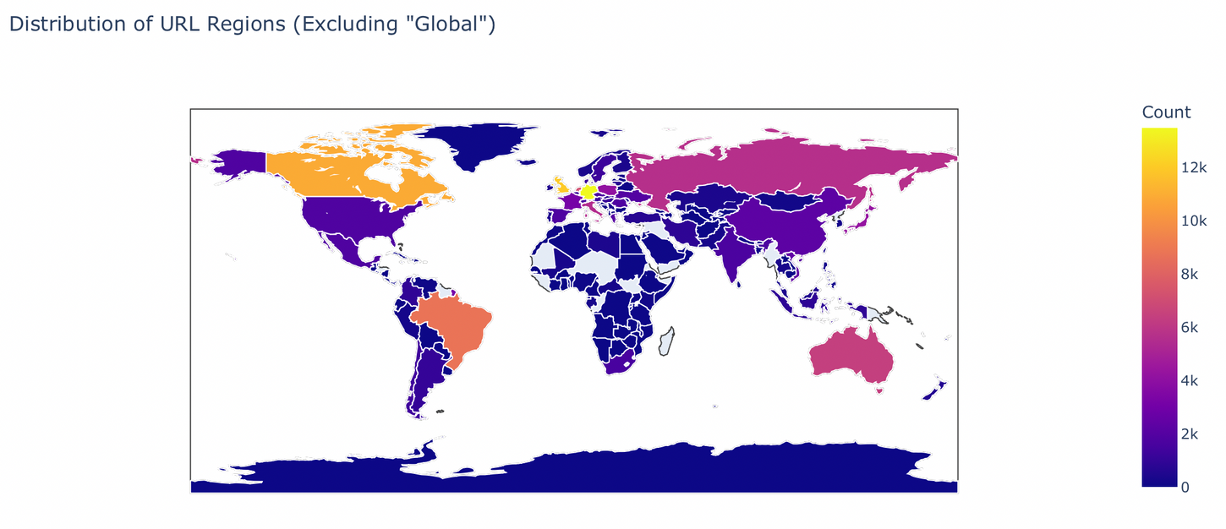
HeatMap Of URLs Per Country

Slide 11


URL Decomposition Techniques

Slide 12
Feature Development
Basic Parsing with ⁠ urlparse ⁠:
Security Indicators:
Splits URL into components: scheme, domain, path, query, fragment.
IP Address Detection: Identifies direct IP usage in URLs.
Shortening Services: Checks for URL shortening to mask destinations.
Length-Based Features:
URL Length: Total characters in the URL.
Suspicious Keywords*: Searches for phrases typically used in phishing (e.g., "login", "update").
Hostname Length: Length of the domain.
Top-Level Domain Length: Extracted using ⁠ tld ⁠.
First Directory Length: Length of the initial directory in the path
Additional Security Checks:
Count-Based Features:
Google Index Check: Determines if the URL is indexed by Google.
Character Count: Periods, hyphens, question marks, percent signs, equals signs, '@' signs.
Abnormal URL Patterns: Analyzes URL structure deviations from norms.
Subdomains and Directories: Count of dots and slashes to assess URL depth.
Security Protocols: Tally of 'https' and 'http'.
Notes:
1.⁠ ⁠URL Length: Measures the overall length of the URL.
2.⁠ ⁠Hostname Length: Calculates the length of the domain extracted from the URL.
3.⁠ ⁠Count of 'www': Tally of 'www' occurrences in the URL.
4.⁠ ⁠Count of 'https': Counts occurrences of the secure protocol 'https'.
5.⁠ ⁠Count of 'http': Counts occurrences of the non-secure protocol 'http'.
6.⁠ ⁠Count of Dots: Tally of periods, used to gauge domain complexity.
7.⁠ ⁠Count of Percent Signs: Indicates encoding within the URL.
8.⁠ ⁠Count of Question Marks: Marks query sections, often manipulated in malicious URLs.
9.⁠ ⁠Count of Hyphens: Common in domain names; excess may indicate complexity.
10.⁠ ⁠Count of Equals Signs: Used in URL queries for parameter assignments.
11.⁠ ⁠Count of At Signs: At signs can indicate deceptive links or credentials.
12.⁠ ⁠Count of Directories: Estimates directory levels by counting slashes.
13.⁠ ⁠Count of Double Slashes: Potentially indicates malformed or crafted URLs.
14.⁠ ⁠Shortening Service Detection: Identifies URLs shortened by common services to mask malicious sites.
15.⁠ ⁠First Directory Length: Length of the first directory in the URL's path.
16.⁠ ⁠Top-Level Domain Analysis: Extracts and measures the length of the top-level domain.
17.⁠ ⁠Suspicious Keywords Detection: Searches for words associated with phishing or scams.
18.⁠ ⁠Digit Count: Counts the number of digits, which might suggest obfuscation.
19.⁠ ⁠Letter Count: Tally of alphabetical characters in the URL.

Slide 13



Tokenization Techniques
TF-IDF
Count Vector
Bert Tokenization
statistical measure used to evaluate the importance of a word to a document in a collection or corpus.
converts text data into a numerical format by counting the frequency of words in the text. This model is part of the bag-of-words approach
processes text by breaking it down into sub-word units using the WordPiece model, adding special tokens for specific tasks, and converting these into indices, facilitating deep contextual learning from language data.

Slide 14


Machine Learning Techniques

Slide 15
Techniques
Logistic Regression:
Random Forest:
Predicts probabilities using a logistic function, ideal for binary classification of URLs as safe or malicious.
Combines multiple decision trees to improve classification accuracy and control overfitting, robust for diverse datasets.
K-Nearest Neighbors (KNN):
XGBoost:
Classifies URLs based on the labels of their nearest neighbors in the feature space, effective with a clear class separation.
An optimized gradient boosting library that provides efficient, scalable, and accurate tree boosting, highly effective for structured data.
Gaussian Naive Bayes:
Support Vector Machine (SVM):
Assumes feature independence and normal distribution, suitable for large text classification tasks including URL safety.
Identifies the best hyperplane to separate different classes in high-dimensional space, good for datasets with complex boundaries.
Decision Tree:
Creates a model that predicts the target by learning decision rules from features, but may overfit on complex datasets.
Notes:
1.⁠ ⁠URL Length: Measures the overall length of the URL.
2.⁠ ⁠Hostname Length: Calculates the length of the domain extracted from the URL.
3.⁠ ⁠Count of 'www': Tally of 'www' occurrences in the URL.
4.⁠ ⁠Count of 'https': Counts occurrences of the secure protocol 'https'.
5.⁠ ⁠Count of 'http': Counts occurrences of the non-secure protocol 'http'.
6.⁠ ⁠Count of Dots: Tally of periods, used to gauge domain complexity.
7.⁠ ⁠Count of Percent Signs: Indicates encoding within the URL.
8.⁠ ⁠Count of Question Marks: Marks query sections, often manipulated in malicious URLs.
9.⁠ ⁠Count of Hyphens: Common in domain names; excess may indicate complexity.
10.⁠ ⁠Count of Equals Signs: Used in URL queries for parameter assignments.
11.⁠ ⁠Count of At Signs: At signs can indicate deceptive links or credentials.
12.⁠ ⁠Count of Directories: Estimates directory levels by counting slashes.
13.⁠ ⁠Count of Double Slashes: Potentially indicates malformed or crafted URLs.
14.⁠ ⁠Shortening Service Detection: Identifies URLs shortened by common services to mask malicious sites.
15.⁠ ⁠First Directory Length: Length of the first directory in the URL's path.
16.⁠ ⁠Top-Level Domain Analysis: Extracts and measures the length of the top-level domain.
17.⁠ ⁠Suspicious Keywords Detection: Searches for words associated with phishing or scams.
18.⁠ ⁠Digit Count: Counts the number of digits, which might suggest obfuscation.
19.⁠ ⁠Letter Count: Tally of alphabetical characters in the URL.

Slide 16

Results

Slide 17
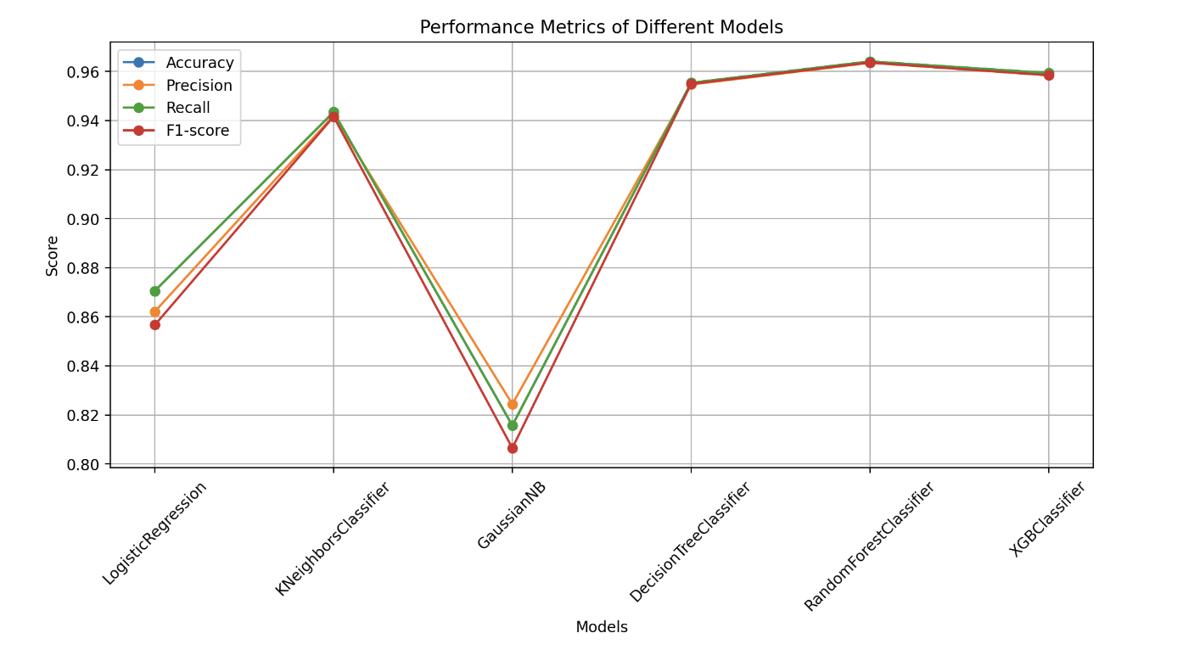
URL-Decomposition

Slide 18
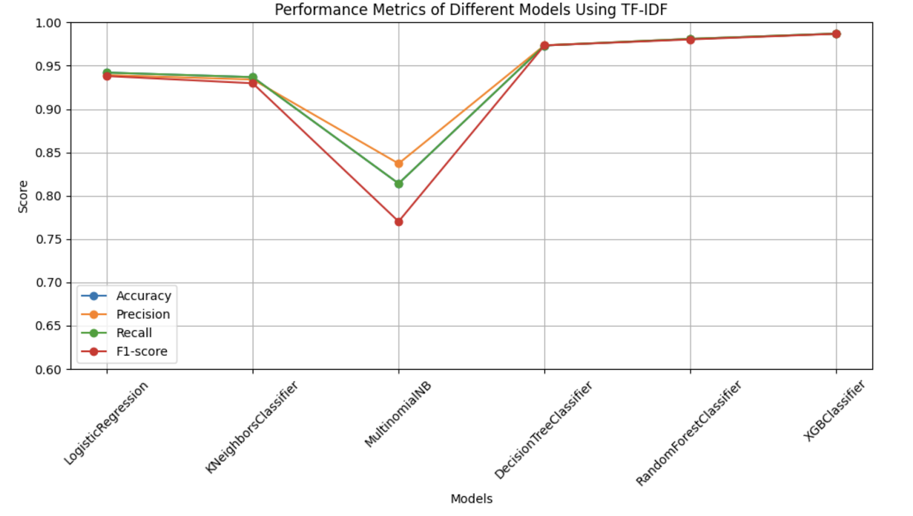
TF-IDF

Slide 19
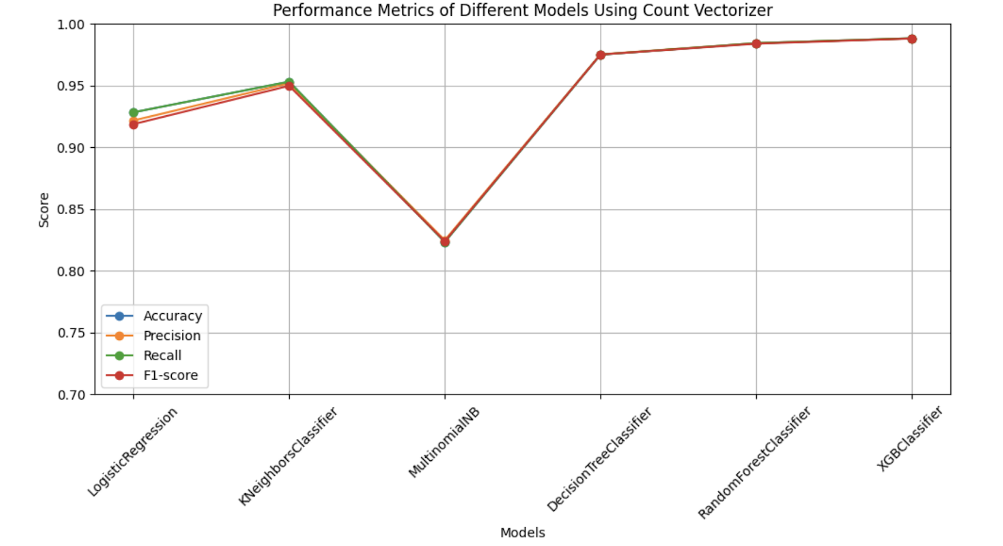
Count - Vectorizer

Slide 20
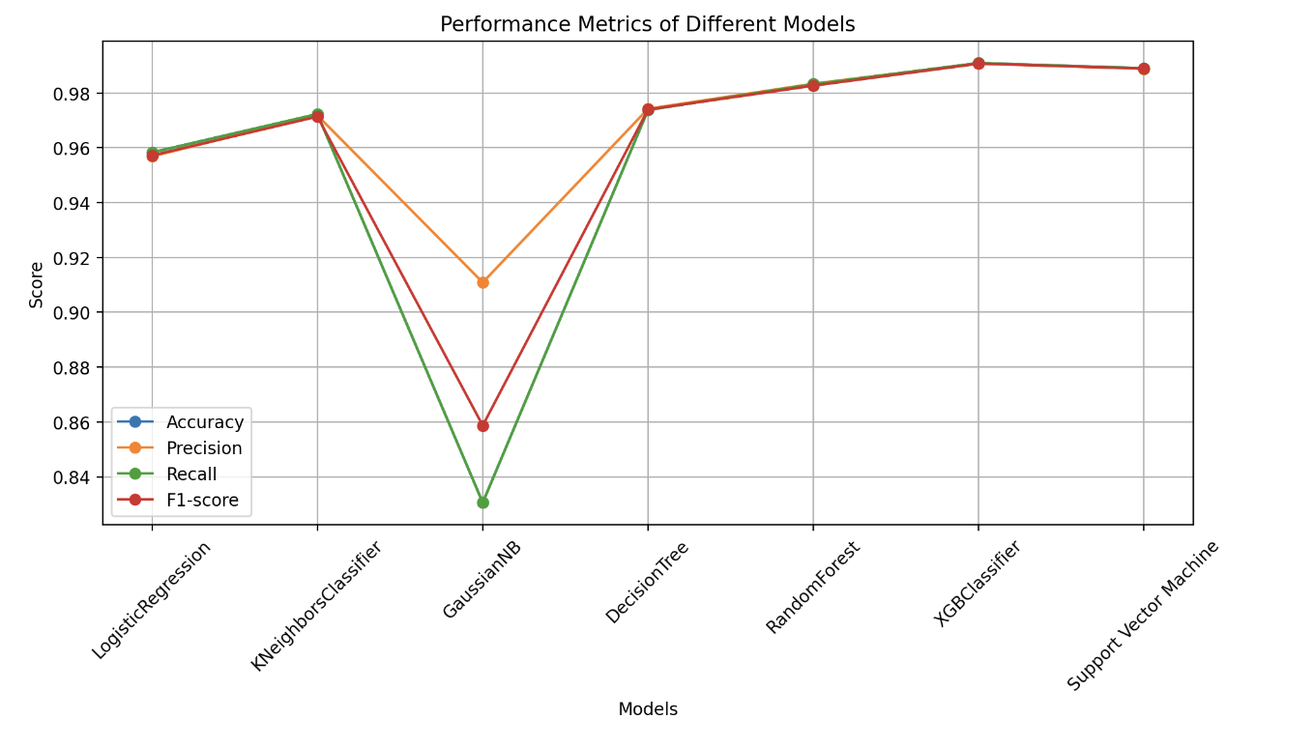
Bidirectional Encoder Representations (BERT)
Notes:
BERT tokenization and generating embeddings involve several steps:
1. **Tokenization**: BERT tokenization breaks down input text into tokens. This involves splitting the text into words, subwords, or characters, depending on the tokenization method used. BERT uses WordPiece tokenization, which can split words into smaller subwords or represent rare words using subword units. Special tokens, such as `[CLS]` (beginning of sequence) and `[SEP]` (separator), are also added to mark the beginning and end of sentences.
2. **Padding and Truncation**: After tokenization, the input sequences may have varying lengths. BERT requires fixed-length input sequences, so sequences longer than a specified maximum length are truncated, and shorter sequences are padded with a special `[PAD]` token.
3. **Conversion to Input IDs**: The tokenized input is converted into a sequence of integer IDs corresponding to the tokens in BERT's vocabulary. Each token is mapped to its unique ID.
4. **Segment IDs**: If the input consists of multiple sentences (as in question answering or sentence-pair classification tasks), segment IDs are assigned to distinguish between different segments. For single-sentence tasks, all segment IDs are typically set to 0.
5. **Attention Masks**: An attention mask is created to indicate which tokens are actual words and which are padding tokens. This mask helps the model focus only on the relevant parts of the input during training and inference.
6. **Generating Embeddings**: The tokenized input, along with segment IDs and attention masks, is fed into the BERT model to generate embeddings. BERT produces contextualized embeddings for each token in the input sequence. These embeddings capture the semantic meaning of each token in the context of the entire input sequence.
7. **Pooling**: In some cases, a pooling operation is applied to obtain a fixed-size representation of the entire input sequence. Common pooling strategies include taking the mean or max pooling over the token embeddings.
8. **Output**: The final output of the process is a set of embeddings representing the input text, which can be used for various downstream tasks, such as classification, named entity recognition, or semantic similarity.
By following these steps, BERT tokenization and embedding generation enable the model to understand and process natural language text effectively, capturing both syntactic and semantic information.

Slide 21
Result Analysis
Tokenization and generating embeddings using BERT and training the classification models outperforms all other results.
Similar results has been observed using URL decomposition and BERT techniques for few classification models.
Tokenization, lemmatization, stemming gave bad results except for BERT.
Feature importance scores from XGBoost can provide insights into words or tokens are more influential in making predictions.

Slide 22
Resource Page
https://ar5iv.labs.arxiv.org/html/2310.05953
https://ieeexplore.ieee.org/abstract/document/9633889

Slide 23







Future Scope
The project can be employed in cyber security firewalls for an early malicious URL detection.
The data used is quiet old, most of the malware URL’s have the tendency to change after certain period of time, we can employ pipelines and data scraping techniques to find the URL’s, and train the ML model.

Slide 24
Thank you!
Prasanth Sagar Kottakota (SUID: 969978673)
Sri Krishna Chaitanya Chivatam (SUID: 290797110) Shyam Sudheer Nadella (SUID: 364923152)
Vaibhav Krishna Joshi (SUID: 556679674)
Uday Kumar Putta (SUID: 317626035)

